Slide 1

Real-Time Social Media Data Pipeline with Spark Streaming & Kafka

Slide 2
Builds a real-time data pipeline for Facebook posts
Filters posts with specific keywords
Streams relevant posts to Kafka for analysis
🛠️ Project Overview

Slide 3
What is this Project About?
Real-time ingestion of Facebook posts using Facebook Graph API
Filtering posts based on specific keywords
Sending matched posts to Apache Kafka topic
Designed for scalability and real-time analytics use cases

Slide 4
Facebook Data Ingestion (FacebookDataIngestion.java)
Post Filtering (PostFilter.java)
Kafka Publisher (KafkaPublisher.java)
Real-Time Controller (RealTimeProcessor.java)
Streaming application that reads data in real-time from a Kafka topic, processes it. (SparkKafkaConsumer.java)
🧱 System Components

Slide 5
Purpose: Connects to Facebook Graph API and retrieves posts
Function: fetchFacebookPosts(String accessToken)
Handles HTTP errors and missing data
Returns a JsonArray of post data
📥 Facebook Data Ingestion

Slide 6
Purpose: Extracts posts with specific keywords (e.g., #sports, #news)
Method: filterPosts(List<JsonObject> posts, List<String> keywords)
Outputs: List of FilteredPost objects with post content, matched keyword, word count
🔍 Post Filtering

Slide 7
Purpose: Publishes filtered posts to Kafka topic 'filtered-posts’
Config: Uses localhost:9092, StringSerializer for key/value
Function: sendMessage(String message) sends JSON string messages
📤 Kafka Publisher

Slide 8
Orchestrates the full pipeline
Fetch → Filter → Publish to Kafka
Tracks post IDs to avoid duplication
Runs every 5 seconds, displays summary on shutdown
⏱️ Real-Time Controller

Slide 9
✅ Functional Outcomes
Fetched and parsed Facebook posts
Filtered posts with specified keywords
Streamed filtered posts to Kafka in real-time
Summarized performance on shutdown

Slide 10
📈 Analytical Outcomes
Keyword-specific post counts
Real-time social media trend visibility
Streaming data ready for dashboards and alerts

Slide 11

Screens From Project

Slide 12
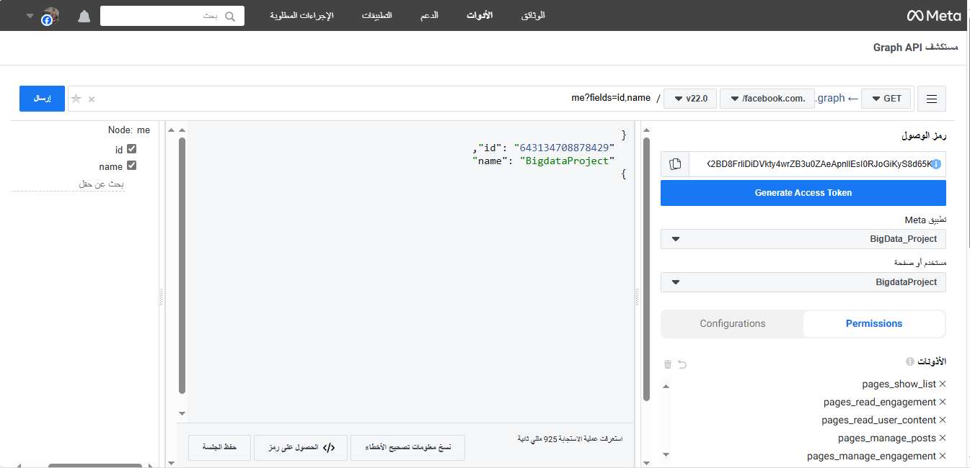

Slide 13
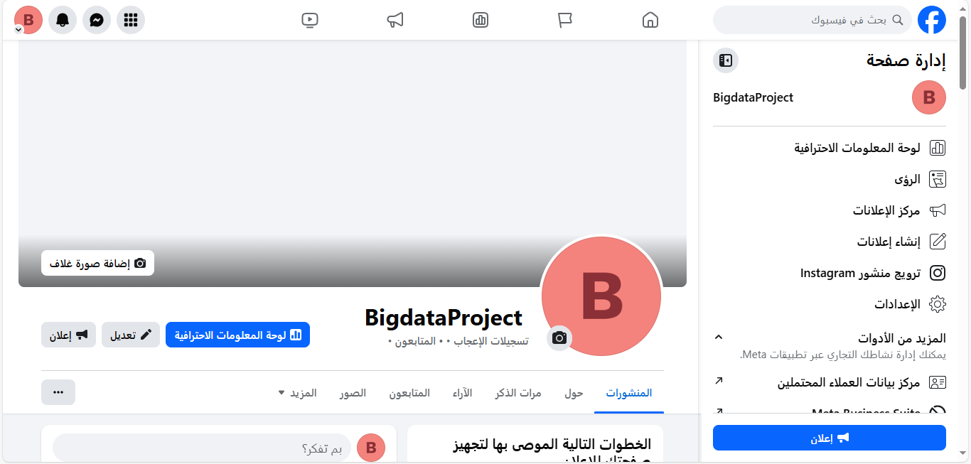

Slide 14
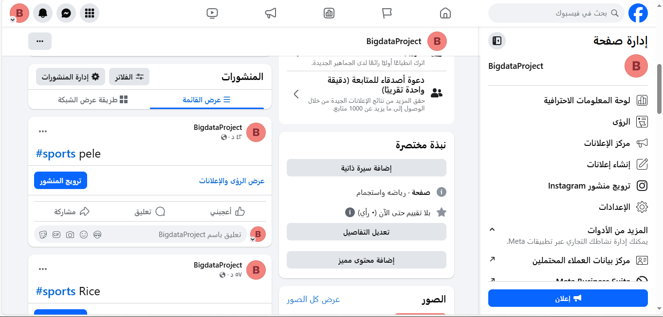

Slide 15
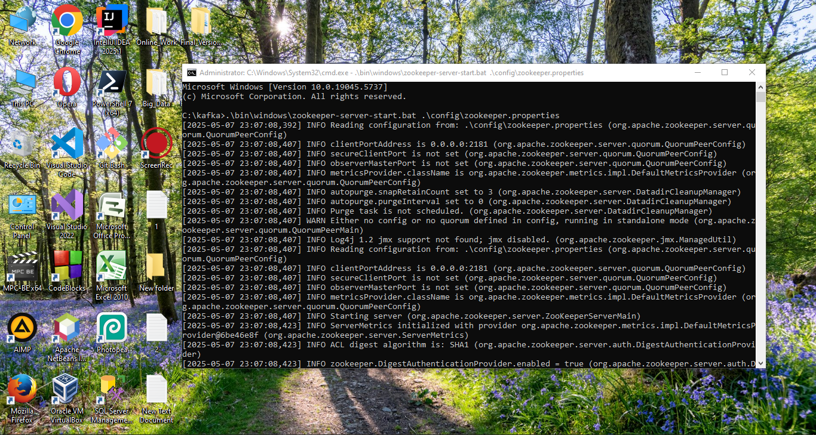

Slide 16
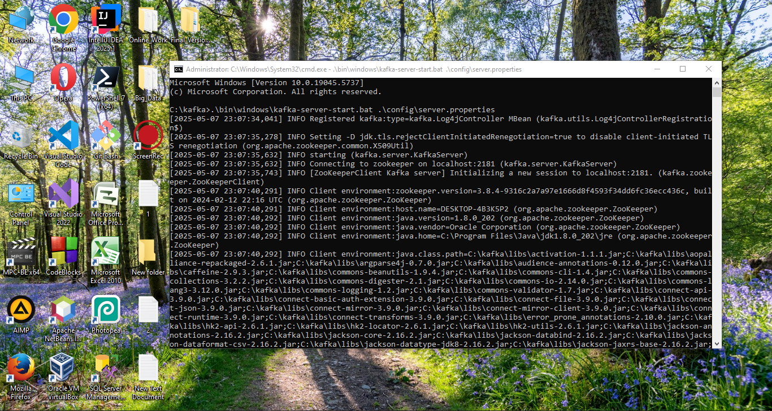

Slide 17
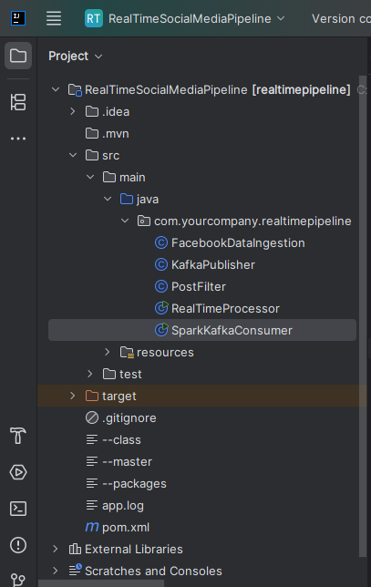

Slide 18
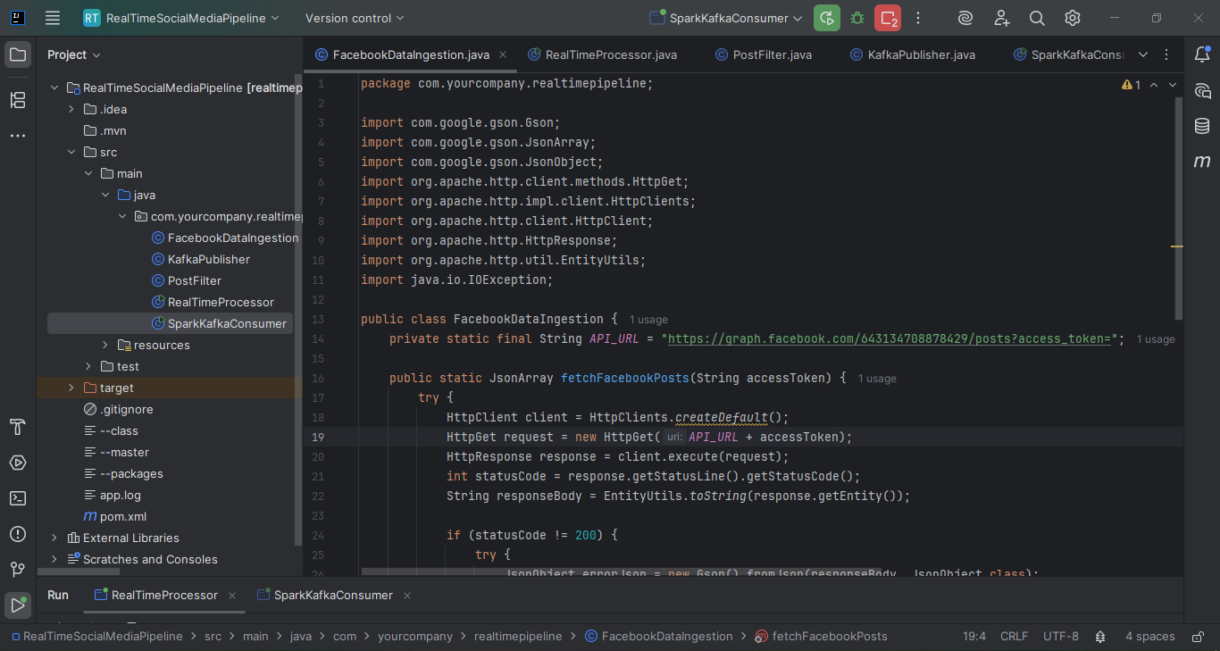

Slide 19
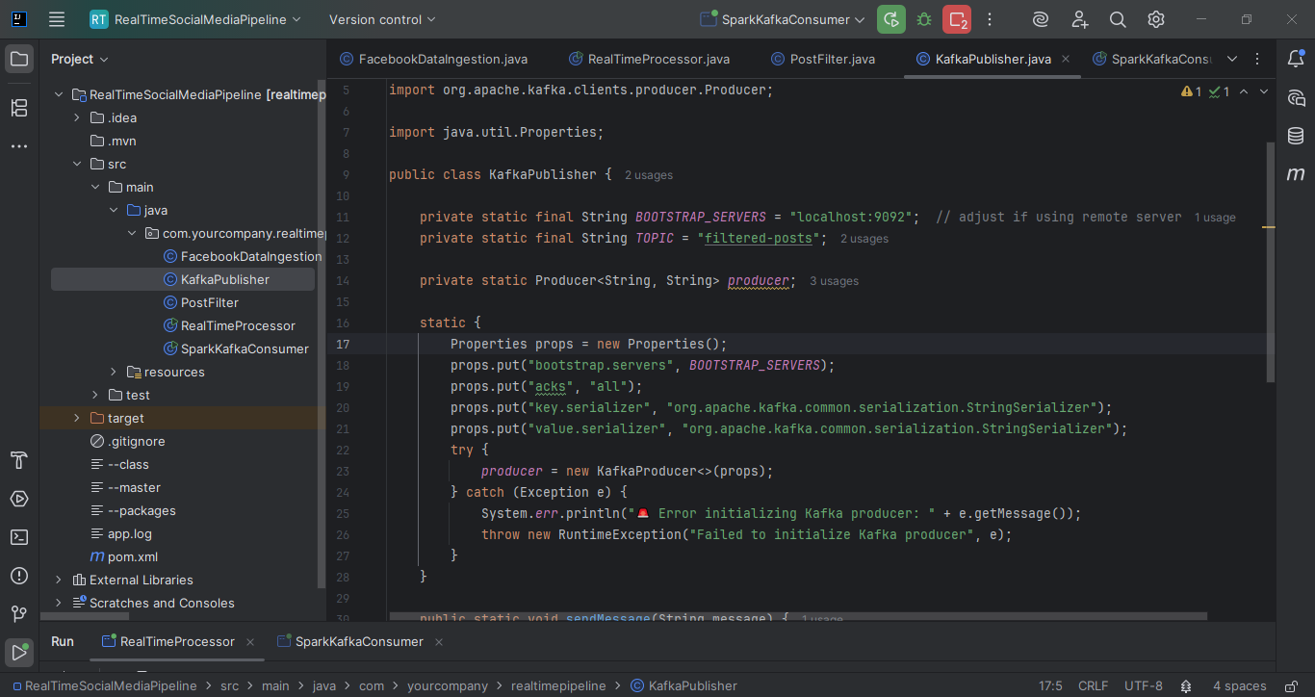

Slide 20
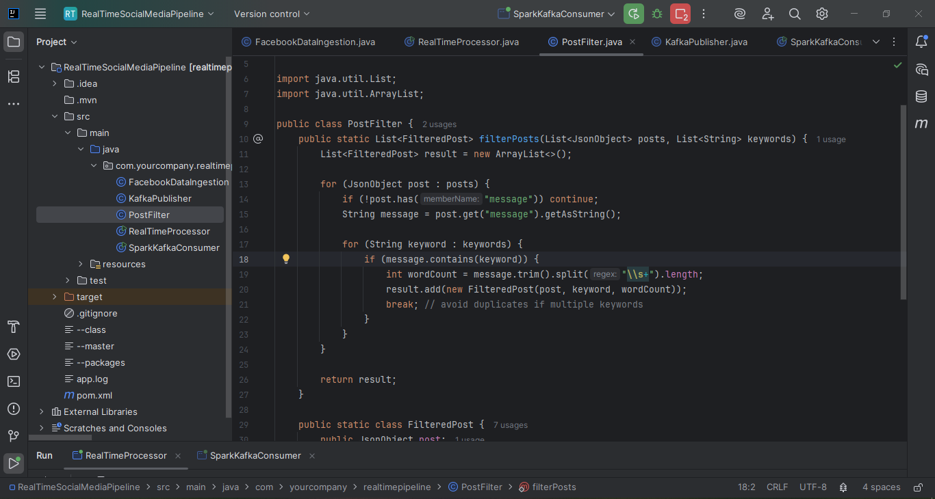

Slide 21
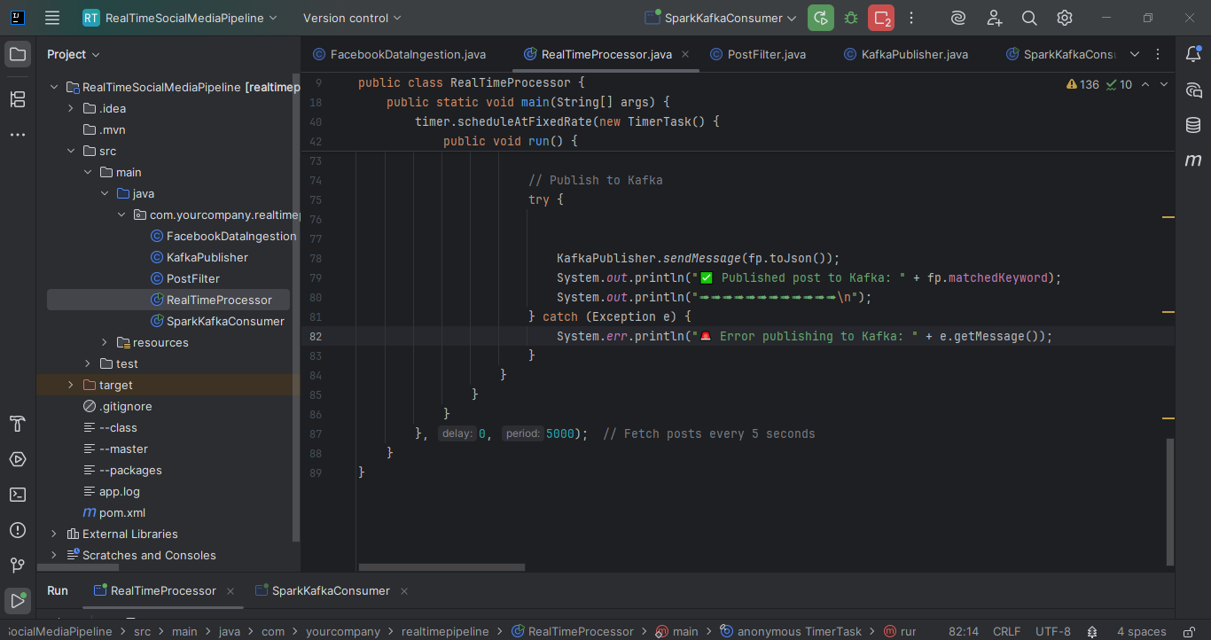

Slide 22
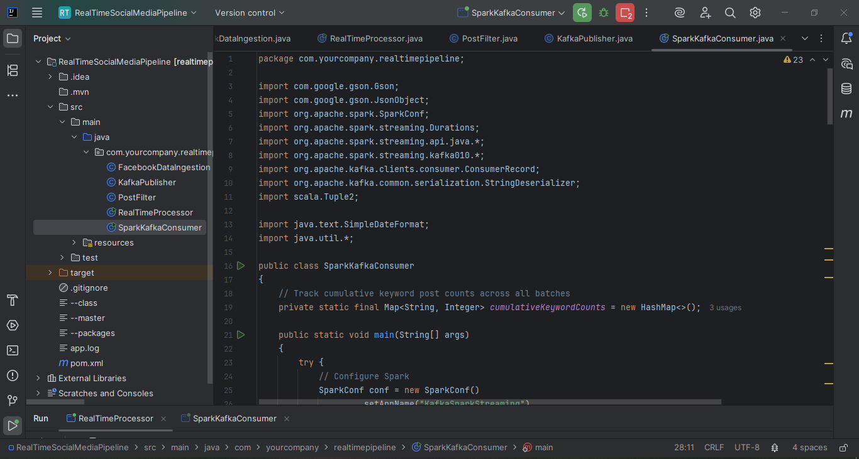

Slide 23
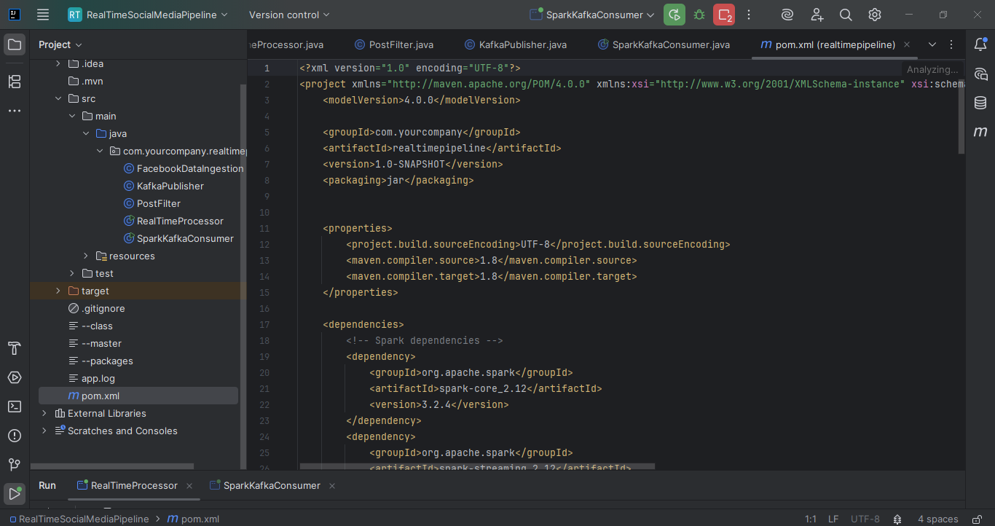

Slide 24
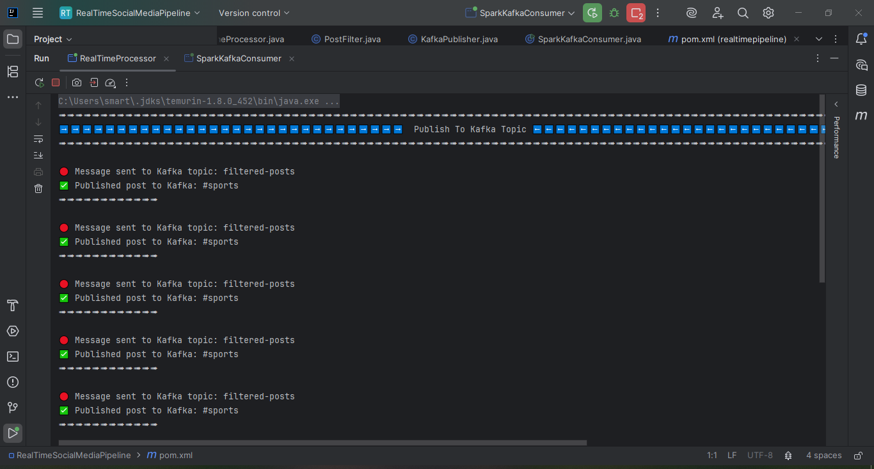

Slide 25
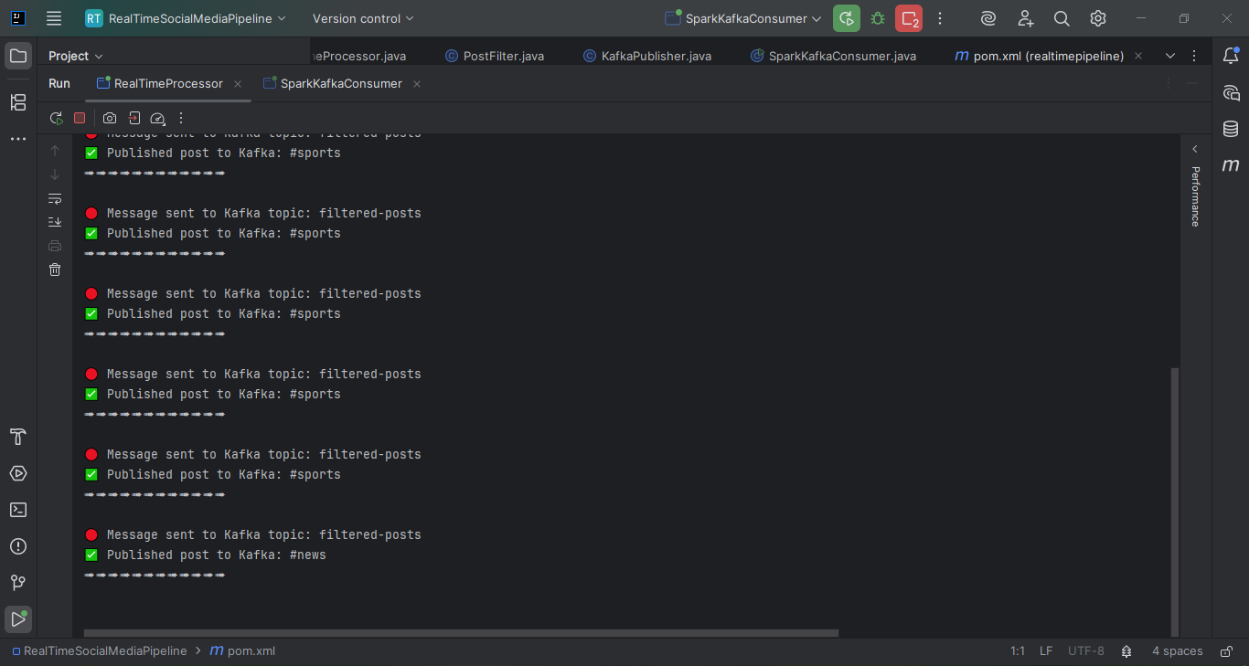

Slide 26
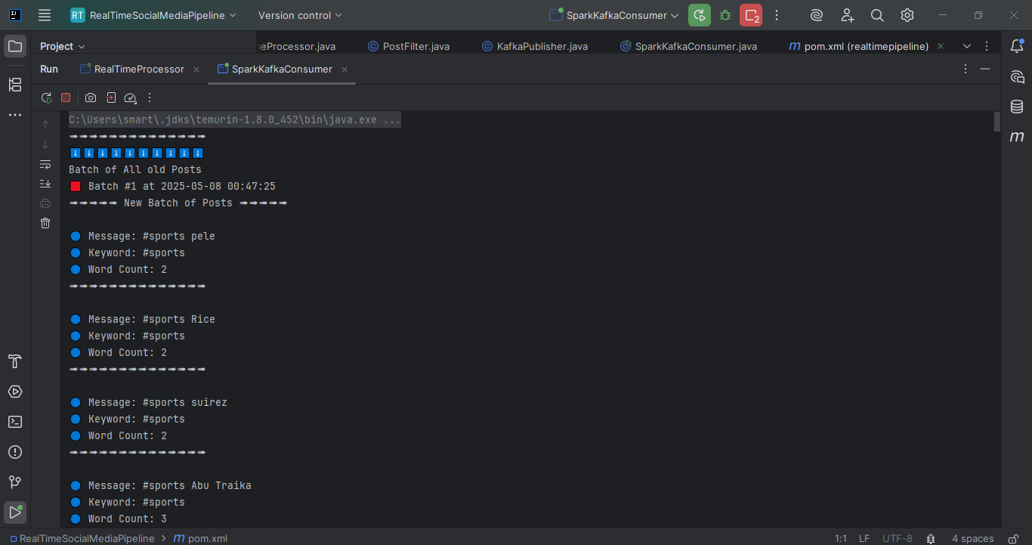

Slide 27
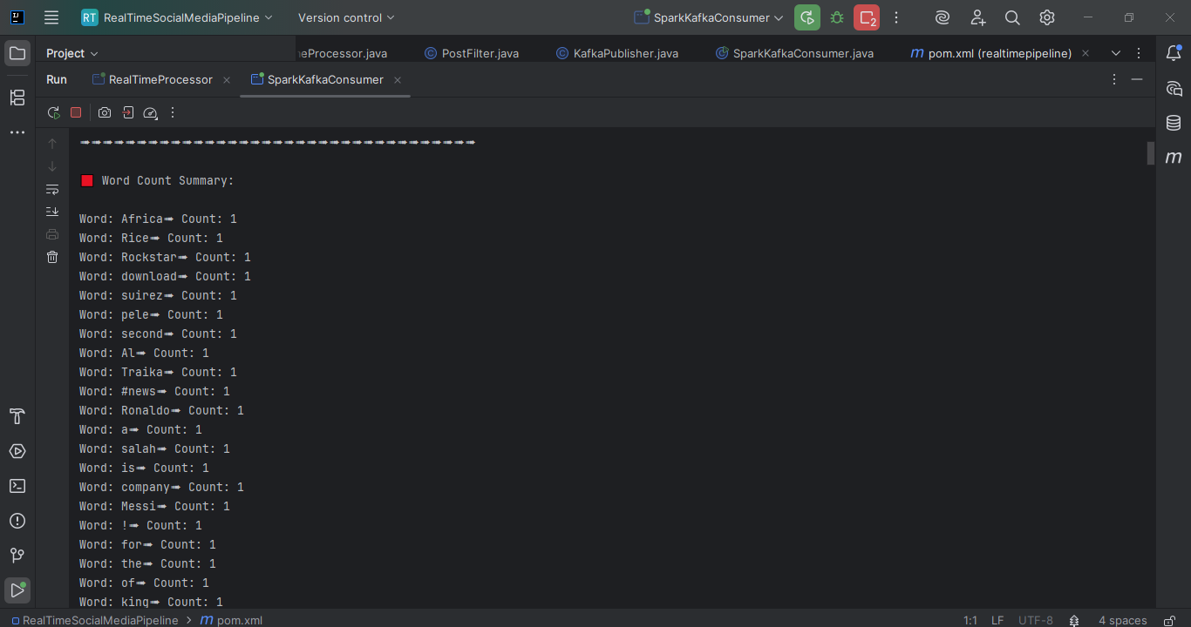

Slide 28
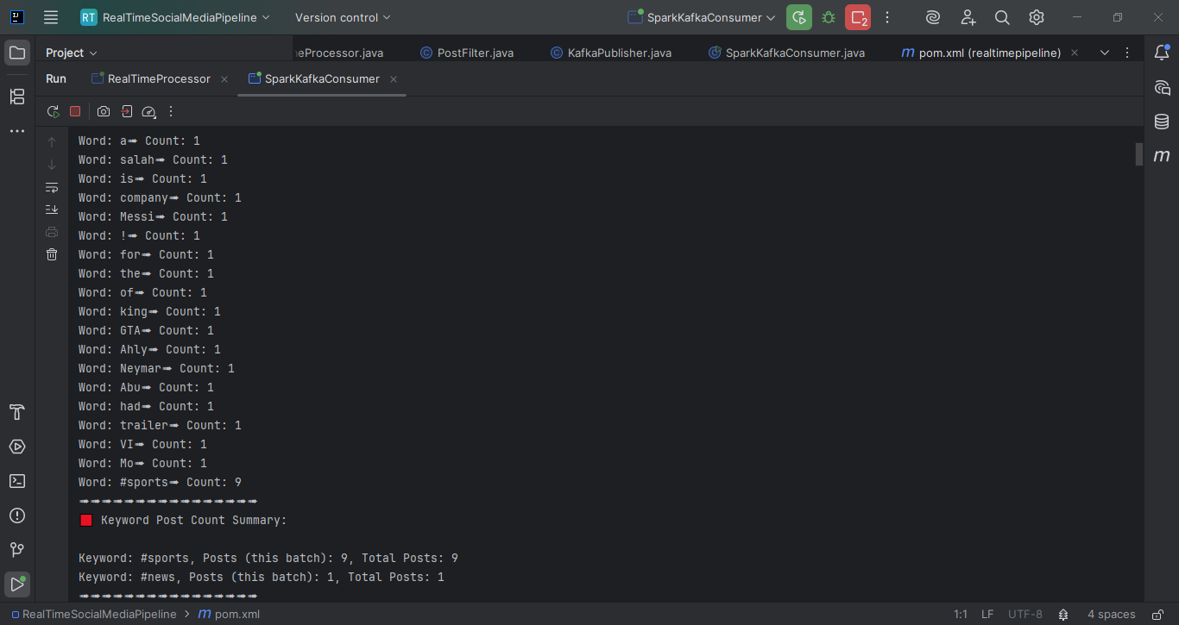

Slide 29


Slide 30
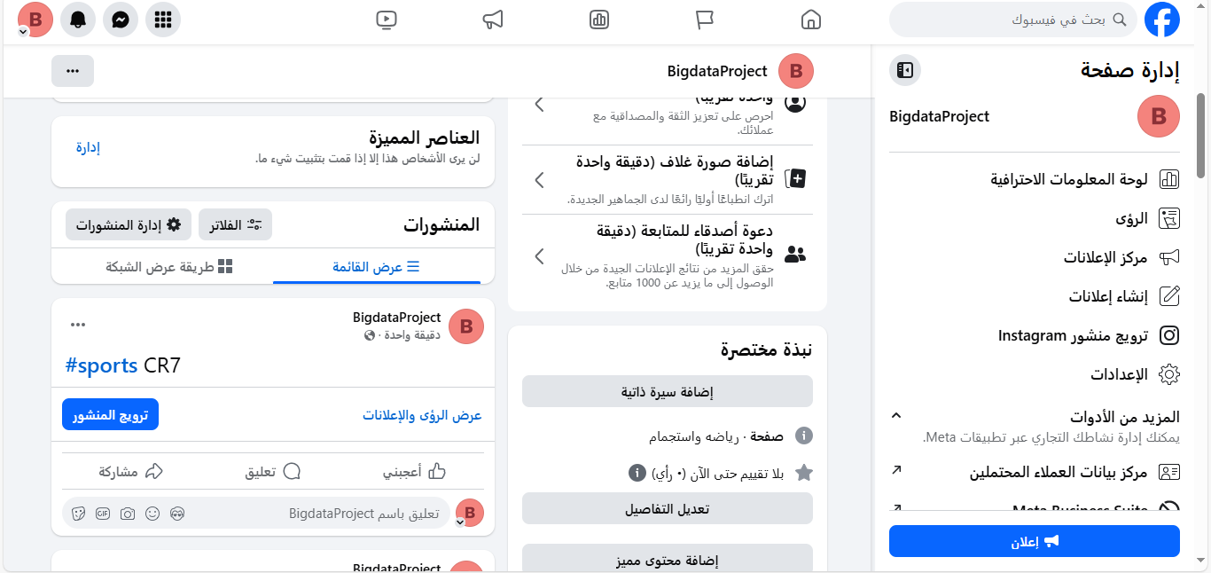

Slide 31
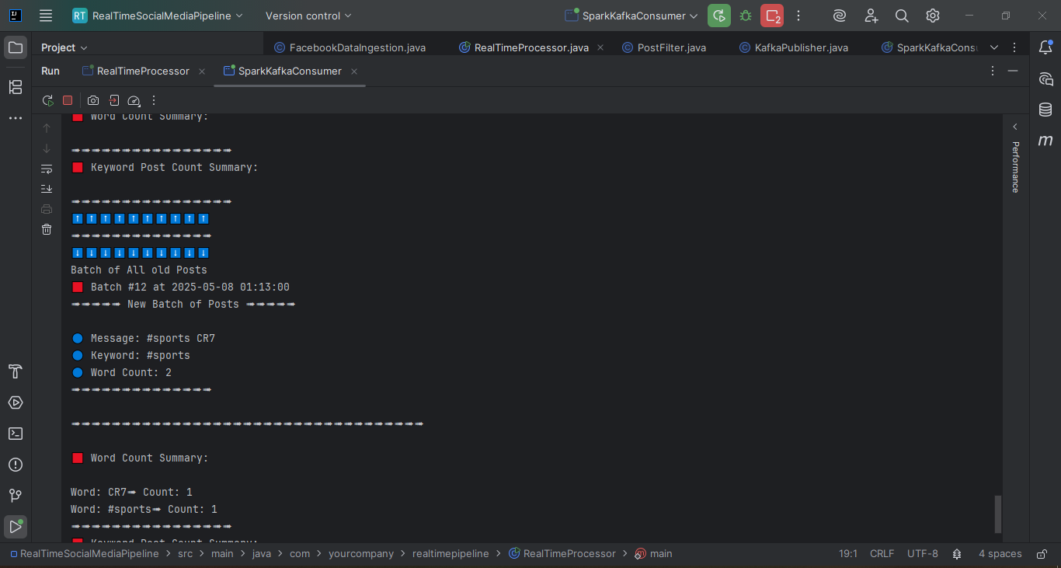

Slide 32
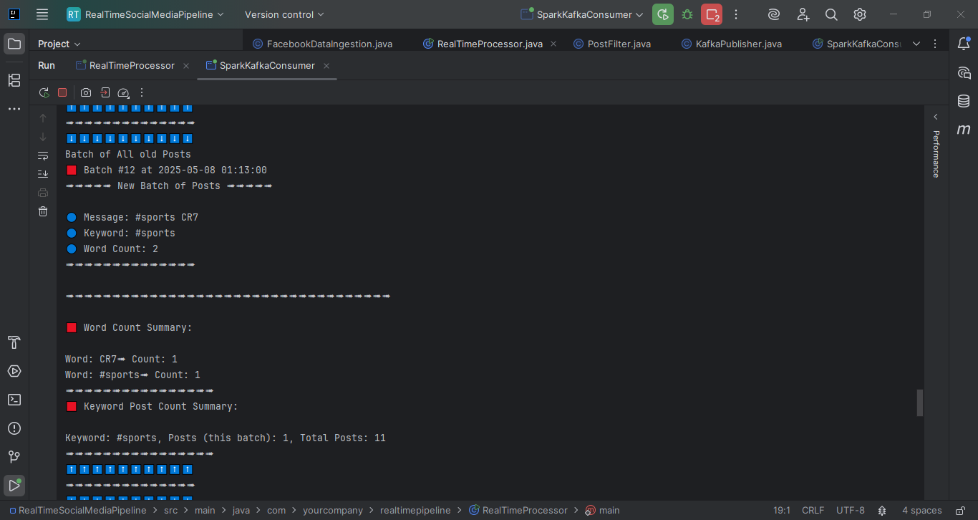

Slide 33

Conclusion
This Project serves as a robust solution for real-time data processing by combining the strengths of Apache Kafka and Apache Spark. It enables applications to ingest, process, and analyze streaming data efficiently, ensuring scalability, fault tolerance, and low latency. This integration is particularly beneficial for use cases like real-time analytics, monitoring systems, and event-driven architectures.

Slide 34

Thank You

